Slide 1

Presentation for Attendance Sheet Application
Name = Suraj Mandal
Roll = 34
Stream = BCA 3rd Year
Registration no = 1173511010034
SWAMI VIVEKANANDA INSTITUTE OF MODERN STUDIES

Slide 2
Introduction
What is Attendance sheet?
It is a mobile application which will bring revolution which will bring revolution in attendance system in school, colleges and as well as different types of Cochin institutions. We thought about this, and build this application. It is basically a mobile application, but it has also an admin panel which will help to control the whole app from the web. Admin can give access any one whom he want.
Why do we use this application?
This application will help any institution to look after the system associated with the present or absent of a student individually on a subject. From this app admin can know the no of classes and number of attended classes by a student. And besides that this is an efficient process of attendance system. For attendance all we need to install this app in our mobile phone, that’s it. A teacher wouldn’t have to carry an attendance copy any more.

Slide 3
Things used in this project:
React- for Admin Panel
Flutter & Dart- for Mobile Application
MYSQL- for Database
IDE- Visual Studio Code (For both Admin Panel & Mobile Application)
API Documentation – EXPRESS (Node js)

Slide 4
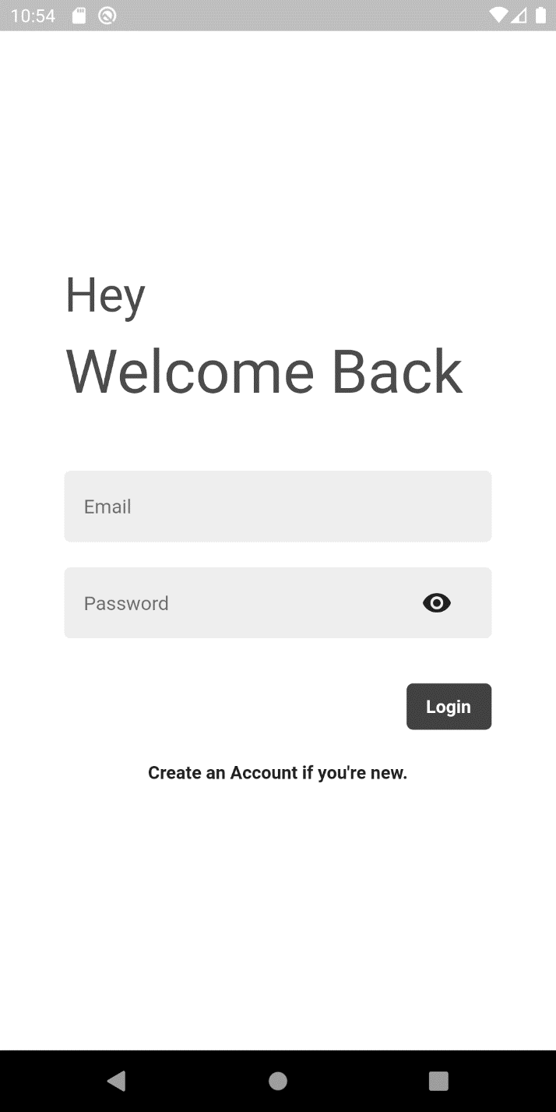
Mobile application
This is the login page of the app. The user have to give details in the proper place. Like: - in the email section user will enter his email address and then in the password section, the password.

Slide 5
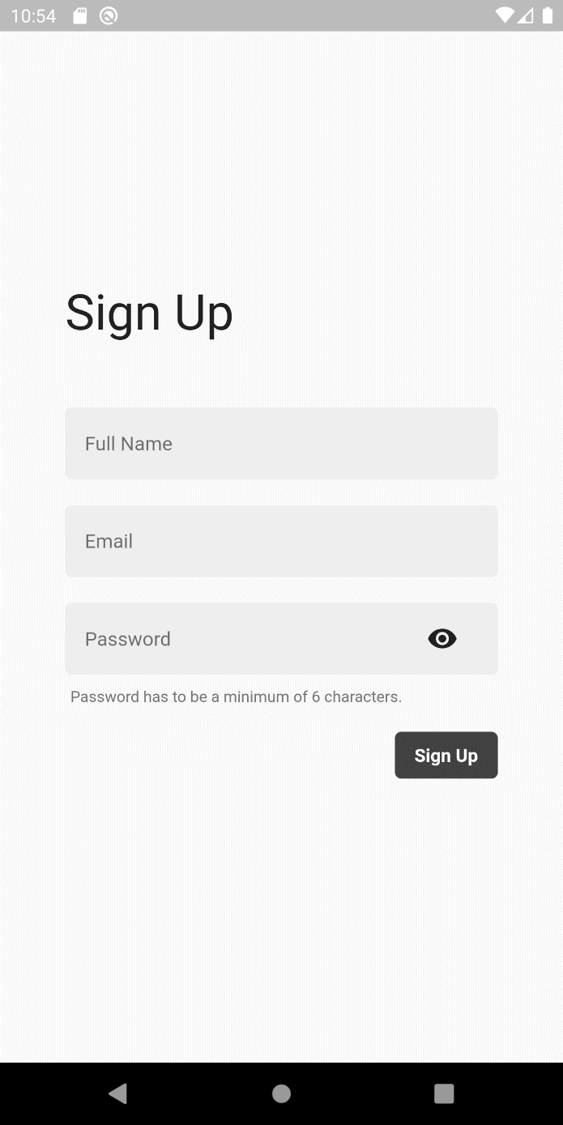
Sign up
When a user is new he or she can sign up through this.

Slide 6
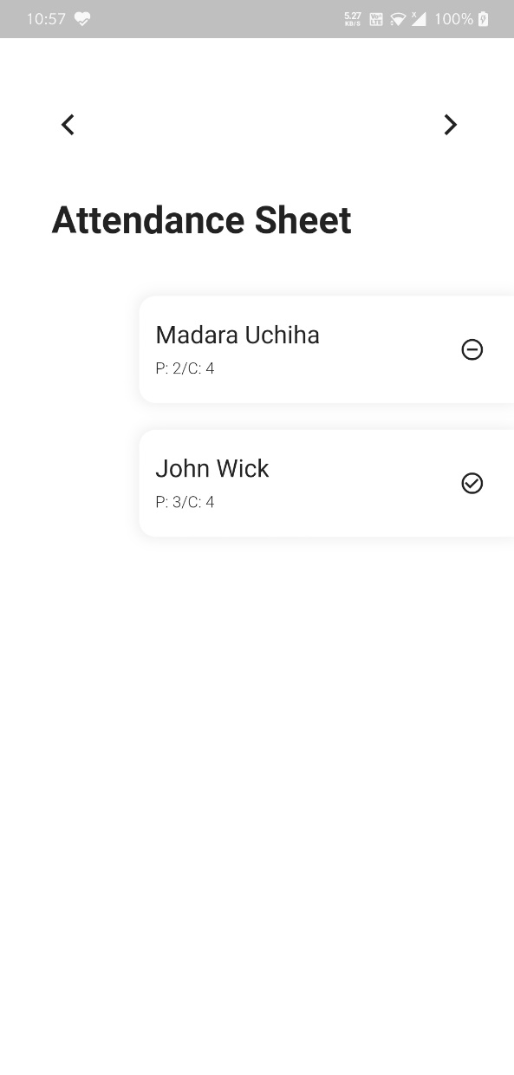
Attendance
In assign subject admin can assign maximum three subject to a user.
After clicking on an individual subject this box will appear, in here all the students name will be showed. And under each student name there is two part
P: (stands for how many classes he or she attended)
C: (stands for how many classes were completed)

Slide 7
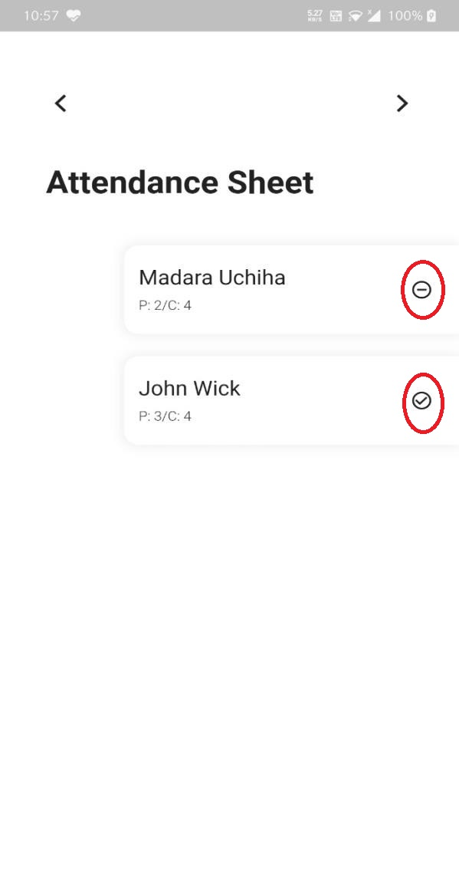
At the right side of each student name there is a option. If he or she is present in that particular subject then after clicking that button a tick mark will appear. And if or she is absent then it will be like this (-)
Shown in the image

Slide 8
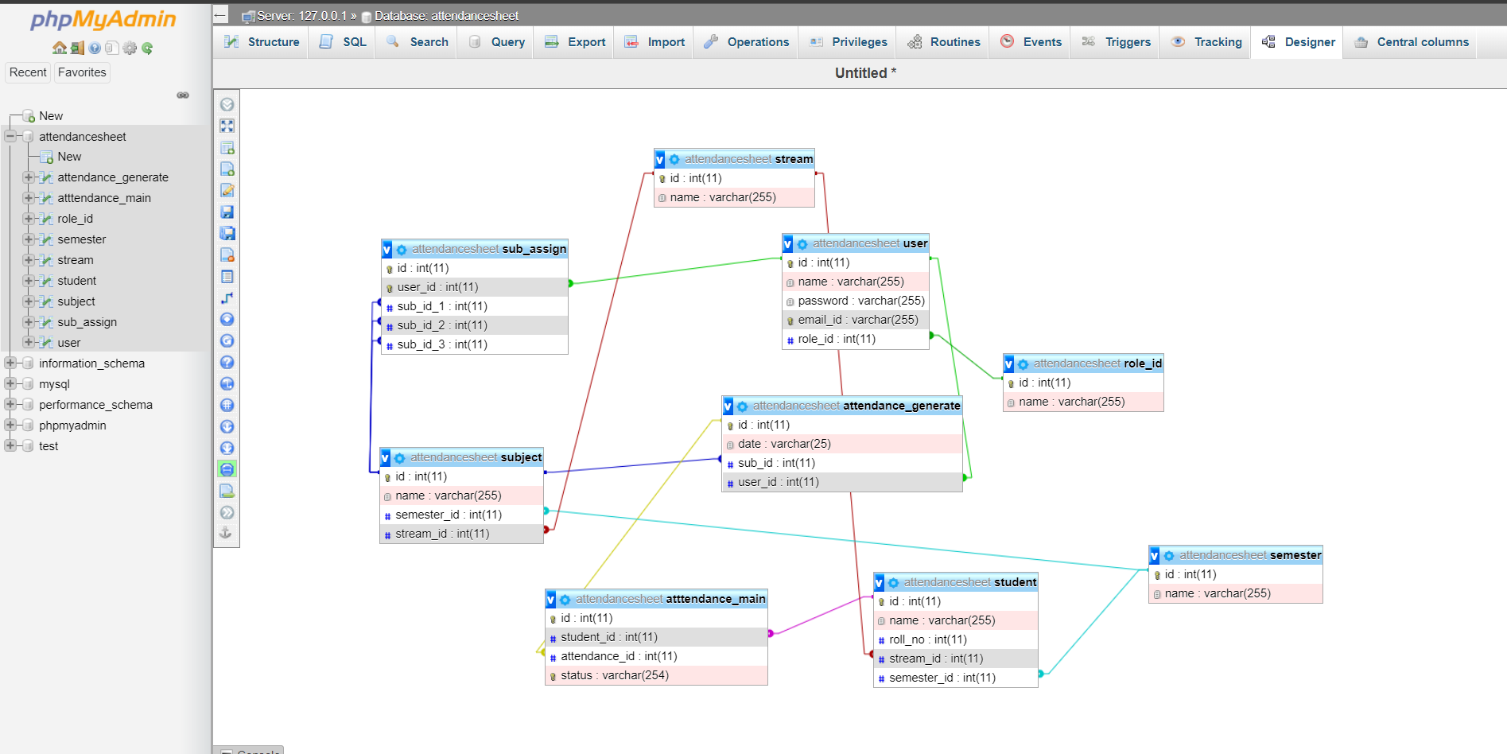
Database

Slide 9
About schema
Starting with subject assign table,
Subject id is connected with the id of the subject table.id of the subject table is working as a foreign key.
user id of the subject assign table is connected with the id of the user table. Id of table is working as a foreign key.
From subject table the id of the subject is working as a foreign key for the attendance generate table.
From subject table the id of the semester is working as a foreign key for the semester table.
From subject table the Stream id is working as a foreign key for the stream table.
From Attendance main table Student id is connected with the id of the student table as a foreign key, whereas the id of the student table is primary key of table.
Again from Attendance main table the attendance id is working as a foreign key for attendance generate table.
And the id of the attendance generate table is primary key of that table.
From student table semester id is connected with the id of the semester table as a foreign key whereas the id of the semester table is primary key.
From student table stream id is connected with the id of the stream table as a foreign key where the id of the stream table is the primary key.
From attendance generate table user id is connected with the user table as foreign key whereas the id of the user table is primary key of the user table.

Slide 10
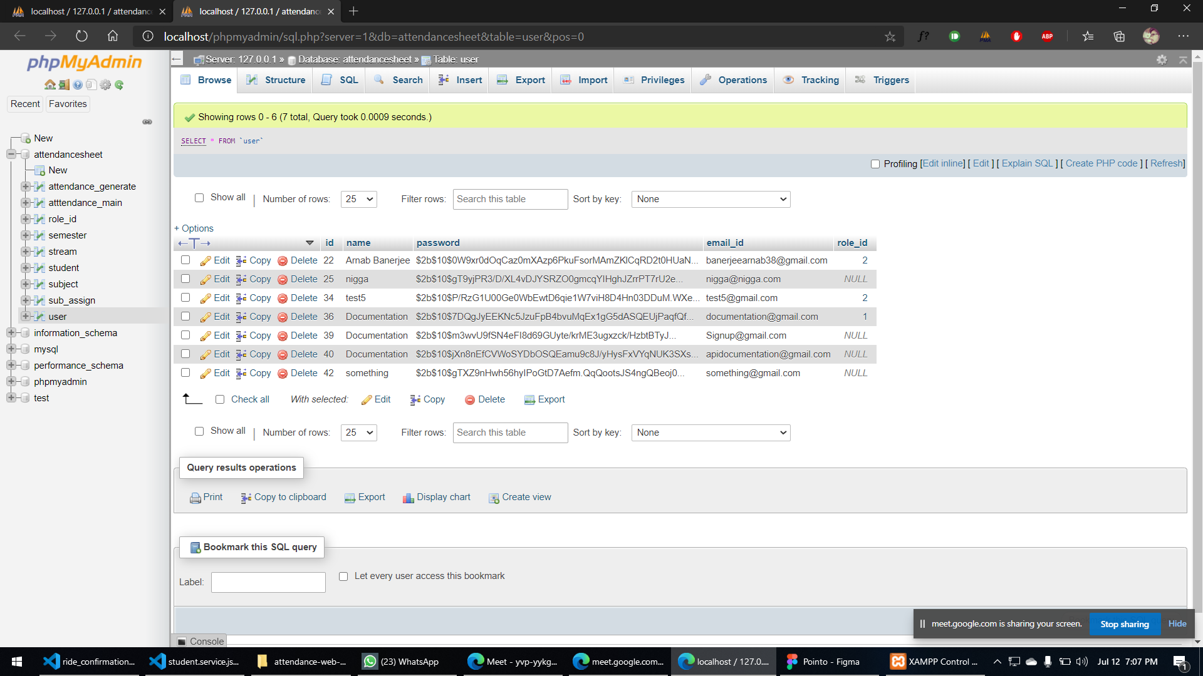
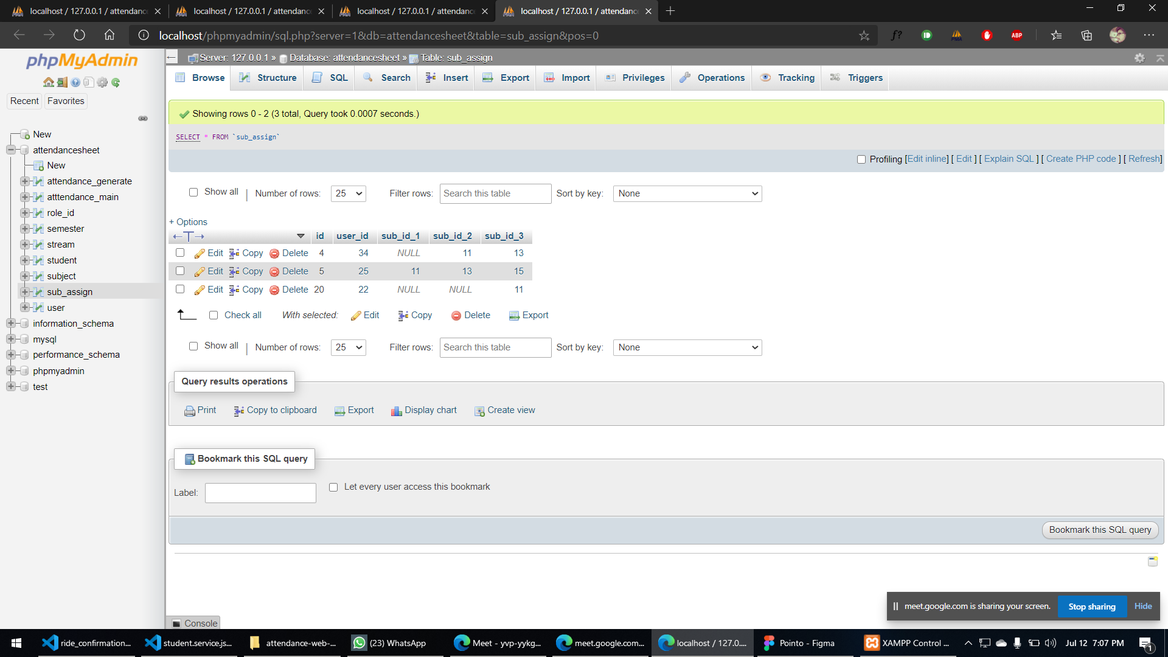
Database Tables(user & Subject assign)

Slide 11
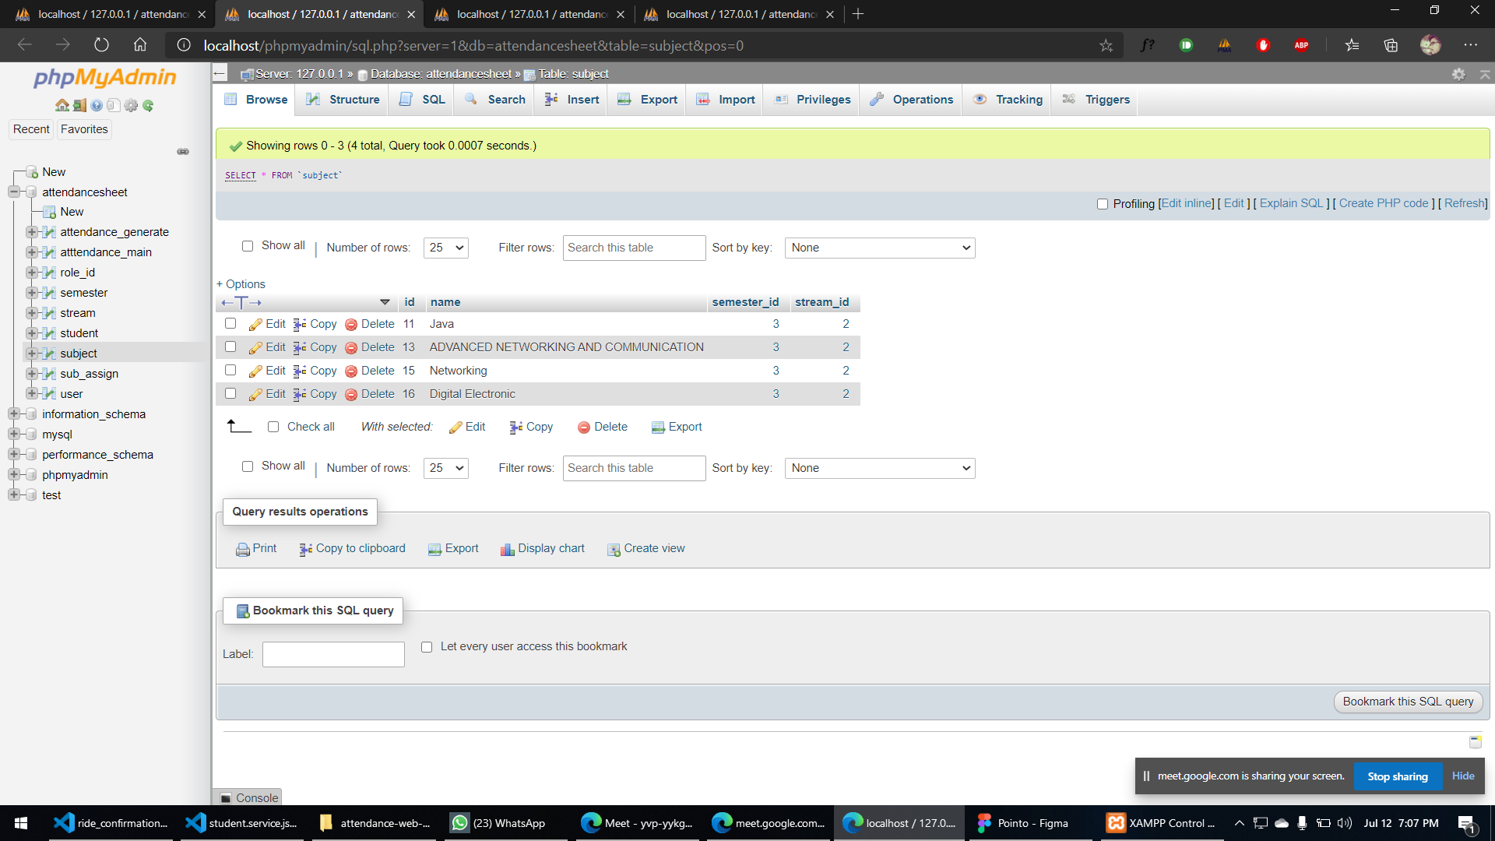
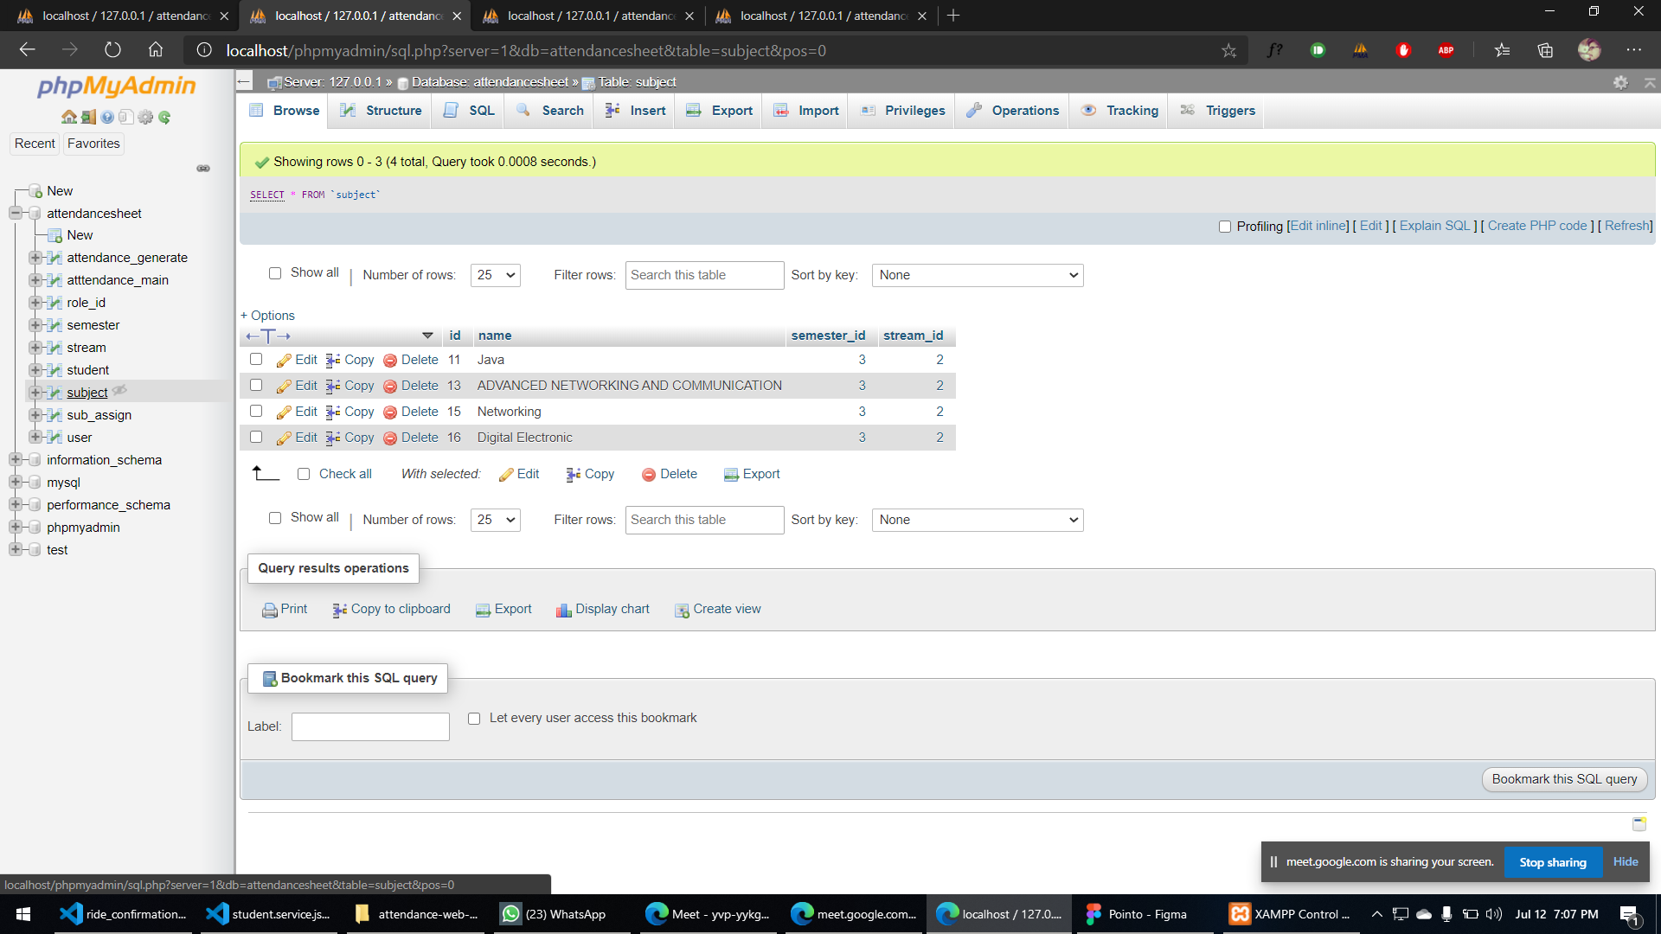
Subject table & Student table

Slide 12
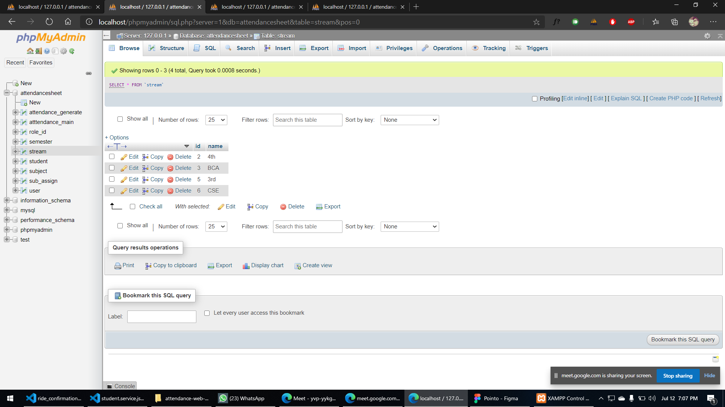

Stream & Semester Table

Slide 13
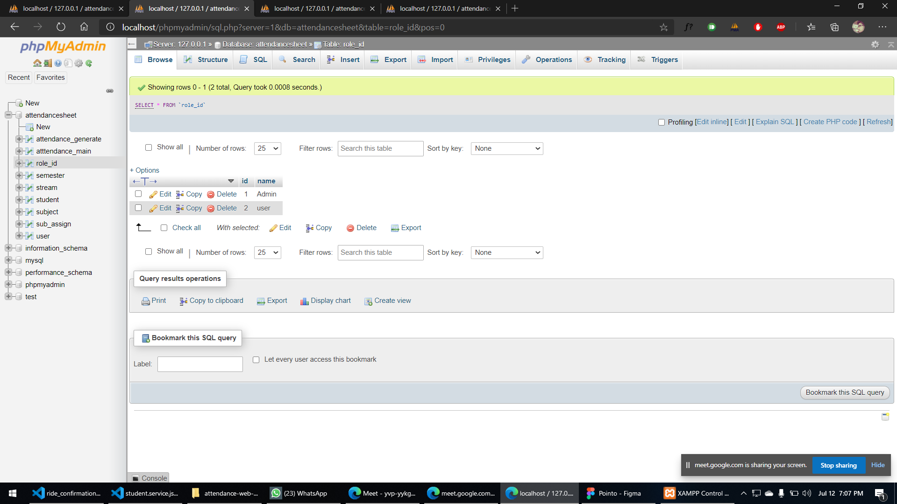
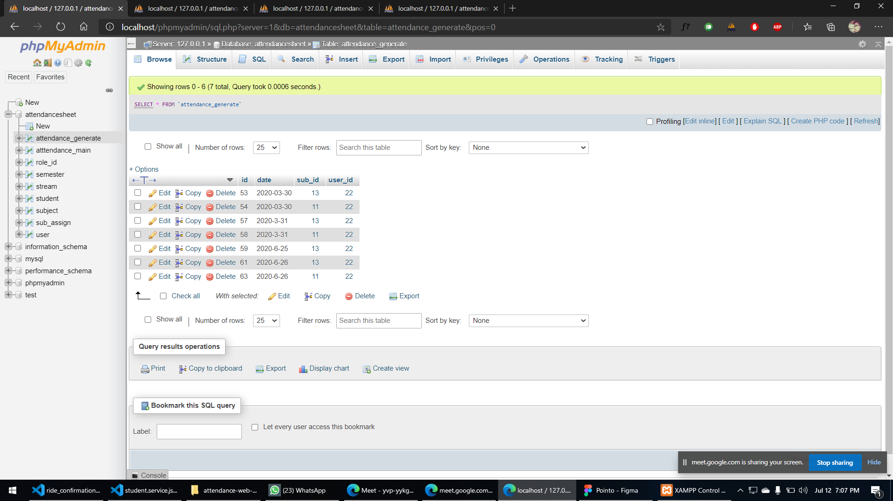
Role id & Attendance main Table

Slide 14
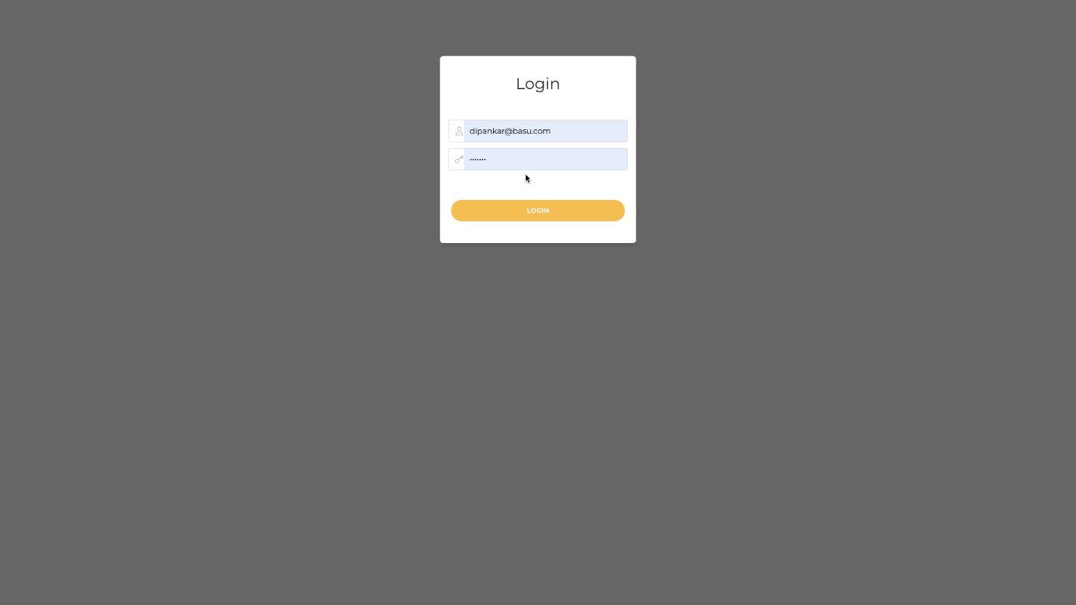
Admin Panel
This is the log in page of the admin panel.
Here the user that means the admin have to put him/her email address and password then he will redirect to the next page shown below.

Slide 15
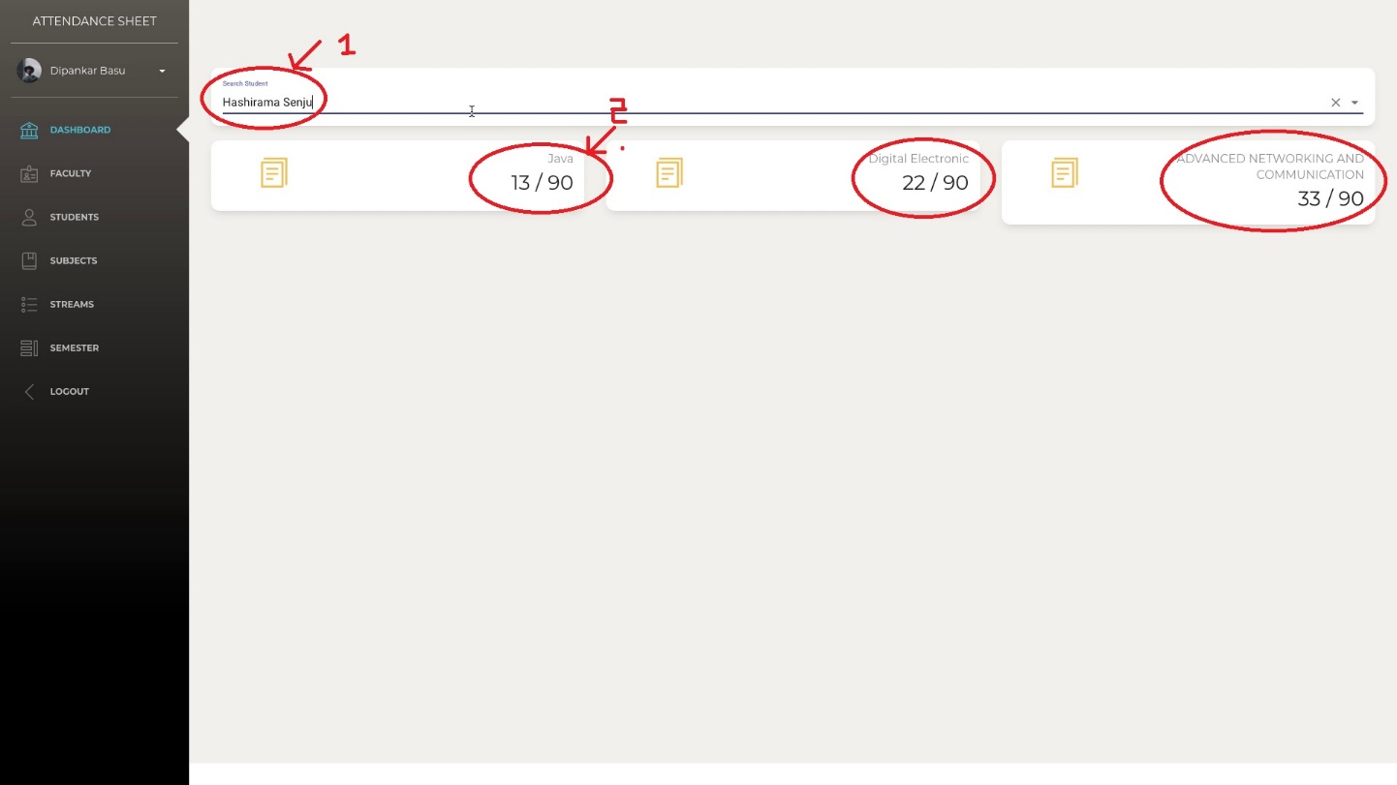
Dashboard
No 1
mark is the place form where admin have to just put the name that he want to search.
In No 2
the brief details about the student will show details that depends on the attendance in a particular subject. And also the how many classes taken for an individual subject.

Slide 16
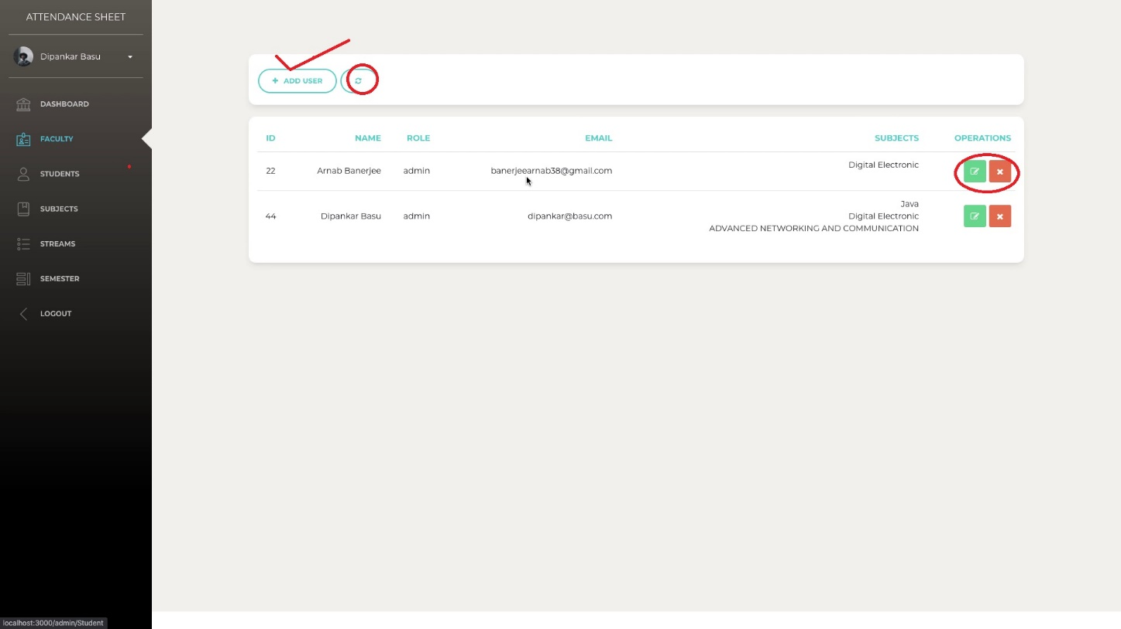
Faculty
Right sign is the option of Add a new user.
Beside of it theirs an option of refresh the page. When admin add a new user or edit the details that was given by him already, then he have to just click the refresh button the updated data will be show.
Theirs two option in the operation one is edit and another one is delete
In the edit page the admin can edit every details.
The image is given in the next page. (Fig: - 6)

Slide 17
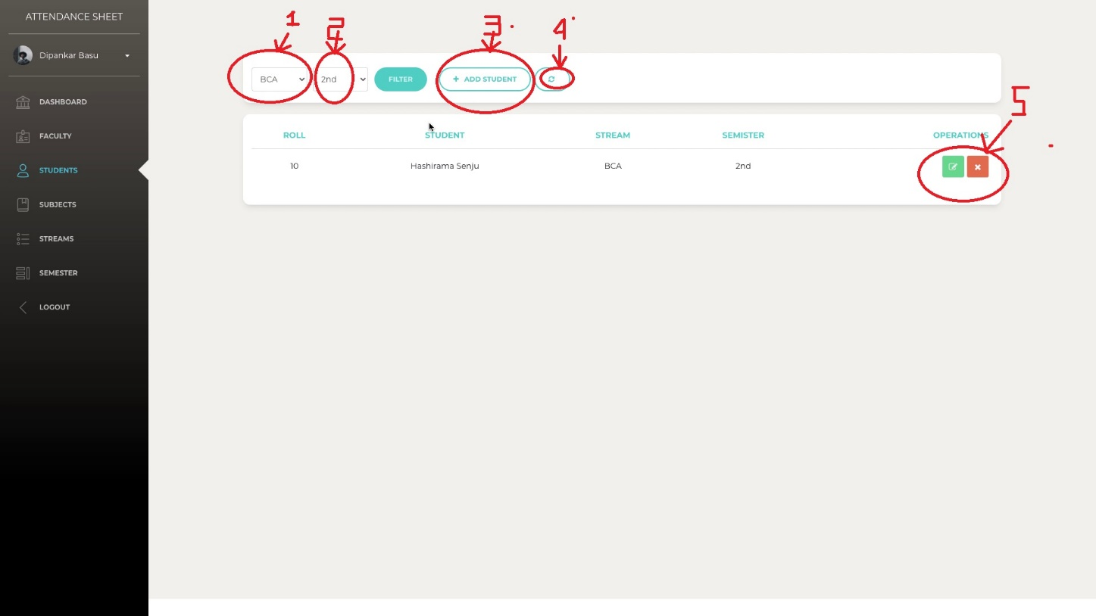
Students
Option 1 = is the box to select the stream.
Option 2 = select the year.
Option 3 = to add the student.
Option 4 = to refresh the page.
Option 5 = to edit or delete the student from the list.

Slide 18
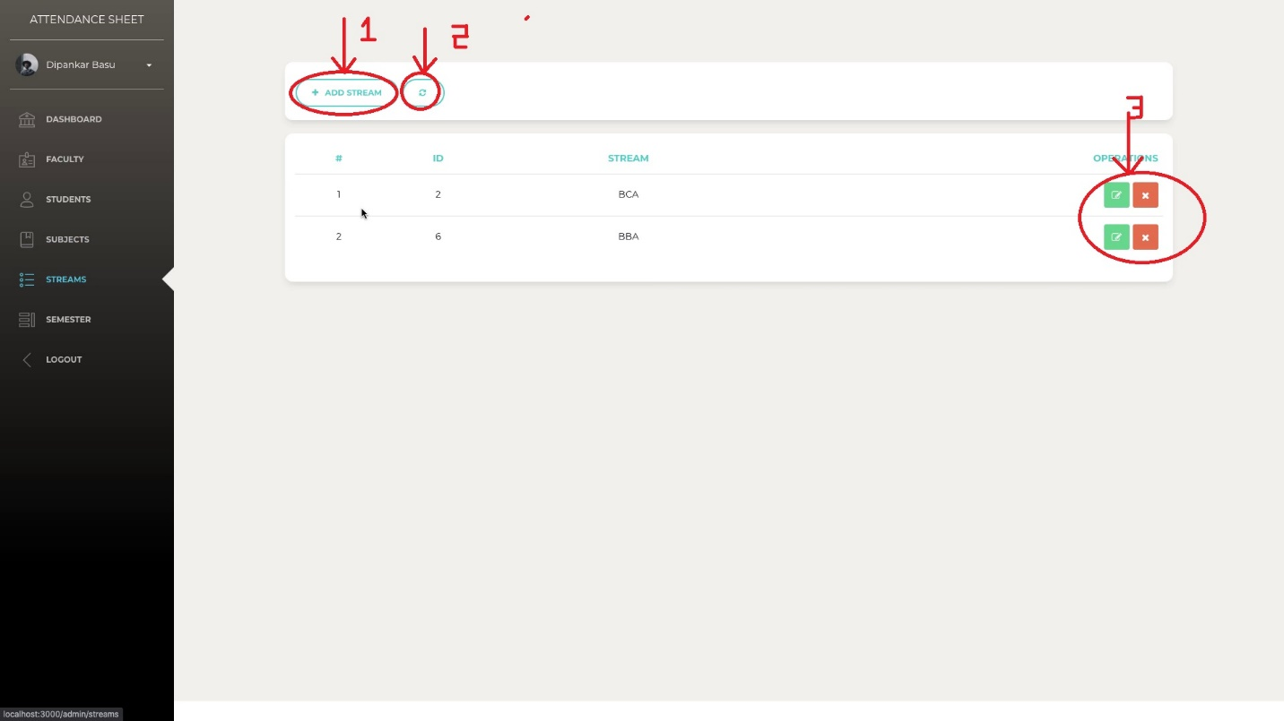
Streams
Option 1 = to add subject.
Option 2 = to refresh the page.
Option 3 = to edit or delete the subject.

Slide 19
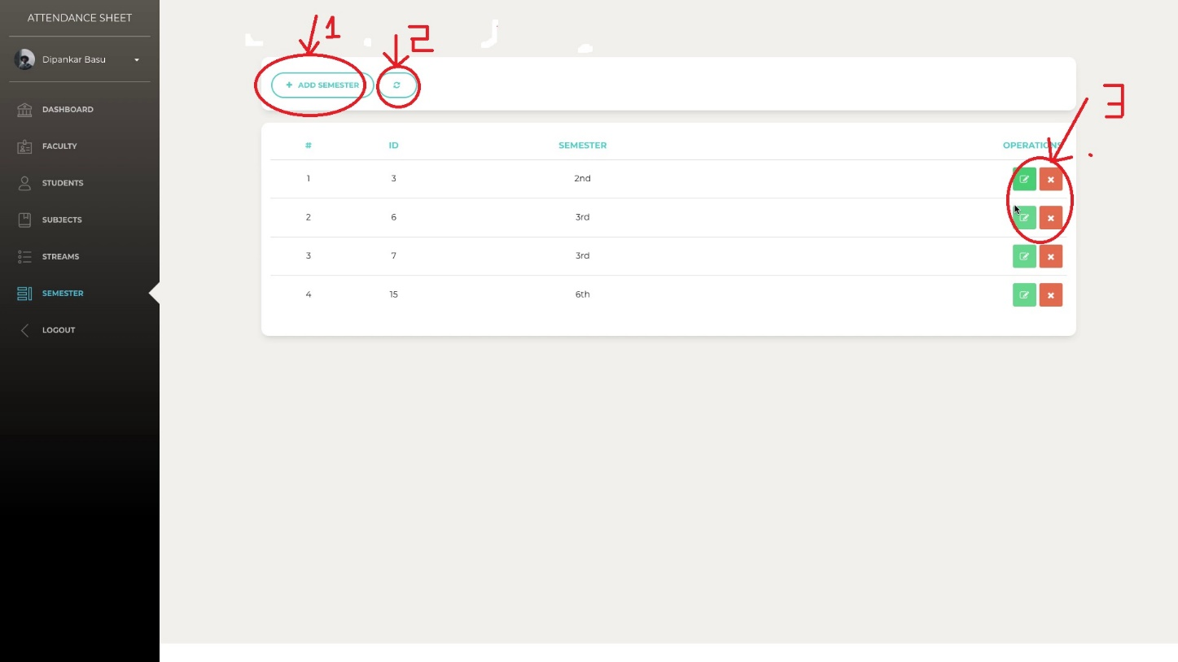
Semester
Option 1= to add semester.
Option 2 = to refresh the page.
Option 3 = to edit or delete semester details.

Slide 20
Acknowledgement
I would like to thank our mentor Mr. Krishna Kumar Maity sir. Whose valuable guidance has been the ones that helped me patch this project and make it full proof success. His suggestions and his instructions has served as the major contributor towards the completion of the project.
Then I would like to thank my group, Arnab Banerjee and Subhadip Kanjilal, who have helped me with their valuable suggestions and guidance has been helpful in various phases of the completion of the project.
Suraj Mandal(Bca/ 3rd year/ 34)

